Slide 1








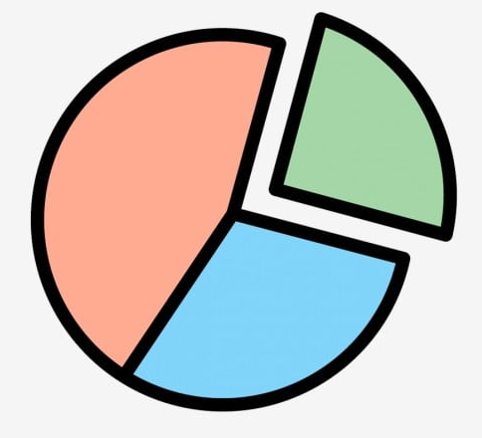

TEAM SYNERGY
Team Members
Aanchal Gaggar
Anurag Patnaik
Gautam Iyer
Shobhit Juyal
Utkarsha Patil
Team Track: Track C (Data Visualization)

Slide 2
Problem Statement
Chosen problem statement: Visualizing India's trade data to provide insights into most important sectors for development and efforts.
The provided dataset consists of trade values for export and import of commodities in India denoted in million USD. The dataset was cleaned to depict each row as a single observation.
A few questions that need to be answered using this dataset are:
What is the overall trade across various geographies?
What is the value of export and import across various years?
Which commodity forms a major chunk of trade?
How has the trade between India and any given country grown over time?

Slide 3
Solution Overview
We have built an interactive EXIM dashboard for analyzing the trade data across geographies in various years.
This dashboard provides insights into India’s trade relations with various countries showing a yearly trend from 2010 to 2018.
It also helps us to obtain a bird’s-eye view of the commodities in demand which have been regularly imported or exported from the country.

Slide 4
Working
Filter
View
Analyze
User can filter data based on their requirements.
Based on the filter, data fields will get updated.
Different graphs will depict data based on user interaction.
User can choose the filter option as per their requirements.
User can also filter data by interacting with Geospatial maps.

Slide 5
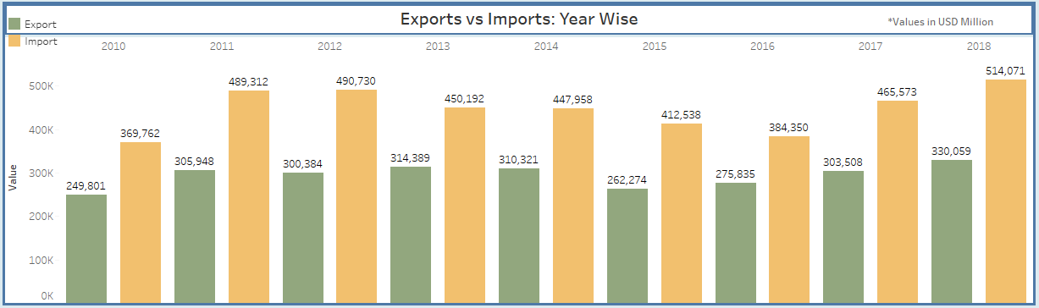
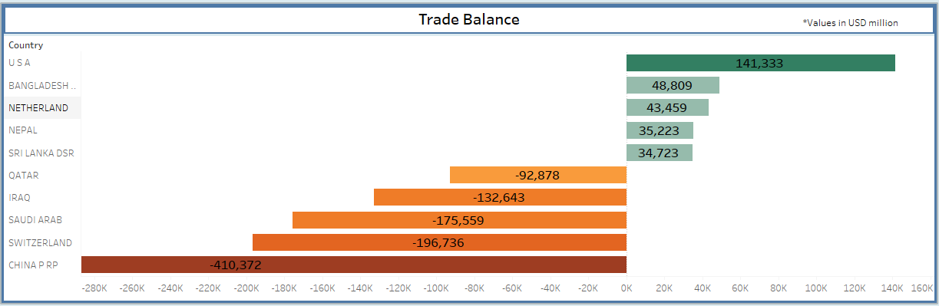
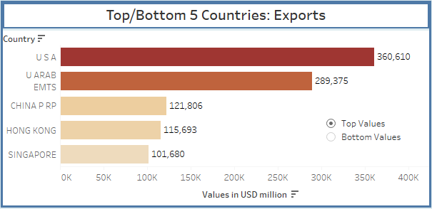
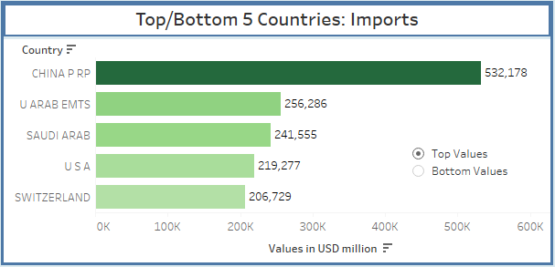
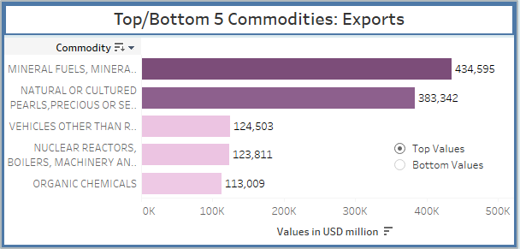
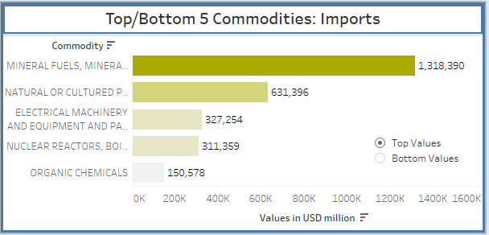
Graphs
Image 1. Graph depicting yearly imports and exports from 2010 to 2018
Image 2. Graph depicting trade balance of countries
Image 3. Graphs depicting the top 5 countries for exports and imports
Image 4. Graphs depicting the top 5 commodities for exports and imports

Slide 6
Insights
Despite the global slowdown, India’s exports increased from USD 249.80 billion in 2010 to USD 330.05 billion in 2018.
The cumulative value of imports in 2010 was USD 369.76 billion as against USD 514.07 billion in 2018, registering an increase of 28 percent. Coupled with the moderate growth in exports, this resulted in an increase in India’s trade deficit from USD 119.96 billion in 2010 to USD 184.013 billion in 2018, contributing to a higher Current Account Deficit (CAD).
The United States of America continues to be the topmost destination for India’s exports with a share of 13.6 percent followed by the United Arab Emirates (10.9 percent) and China (4.6 percent).
In case of Imports, China emerges at the topmost position with a share of 13.22 percent followed by UAE (6.36 percent) and United States of America (5.44 percent). This depicts that India has excellent bilateral trade relations with these three countries contributing to the growth of its economy.
Mineral fuels, mineral oils and their products account for the maximum exports (434 million USD) and imports (1318 million USD) among the top 5 commodities denoting their paramount importance in the foreign trade landscape.
Higher imports of mineral fuels have led to a Trade Deficit with three major countries, namely Qatar (-92,878 million USD), Iraq (-132,643 million USD) and Saudi Arab (-175,559 million USD).

Slide 7
Future Scope
India’s foreign trade policy has helped to increase the country’s share of global trade from 249,801 million USD to 330,059 million USD.
India should actively engage in regional and bilateral trade negotiations to diversify and expand its export markets in order to become a leading player in foreign trade.
It has been observed that imports on electrical machinery and equipment have totaled up to 327,254 million USD. India can focus on domestic production of these commodities in order to reduce dependence on imports, to boost domestic demand and employment opportunities.
Exports on vehicle parts other than railway or tramway rolling stock account for about 124,503 million USD. Providing incentives to increase production of these commodities will help in increasing the exports thereby boosting the foreign exchange reserves of our country.
All these steps will lead to a significant leap towards a favorable balance of trade.
THANK YOU!!

